Slide 1




Human Resources Performance Insights

Slide 2

Our Team
-Ali Tarek
-Ahmed Saber
-Ibrahim Wael
-Habiba Walid
Supervised by Eng. Zyad Ayman

Slide 3


Promblem Overview
Problem: Your Company lack clear visibility into employee trends, hiring efficiency, attrition, and workforce demographics.
Solution: A Power BI dashboard built on a normalized employee database that provides actionable HR insights.
Unique Value Proposition: Combines comprehensive HR metrics with dynamic visuals for real-time decision-making.

Slide 4

Analyze Employee Experience and Career Stage
Understand Hiring Trends
01
04
Analysis Goals
Assess Attrition and Retention
02
Monitor Workforce Demographic
05
Evaluate Salary Distribution and Fairness
Enable Strategic HR Decision-Making
03
06

Slide 5

Processes

Slide 6

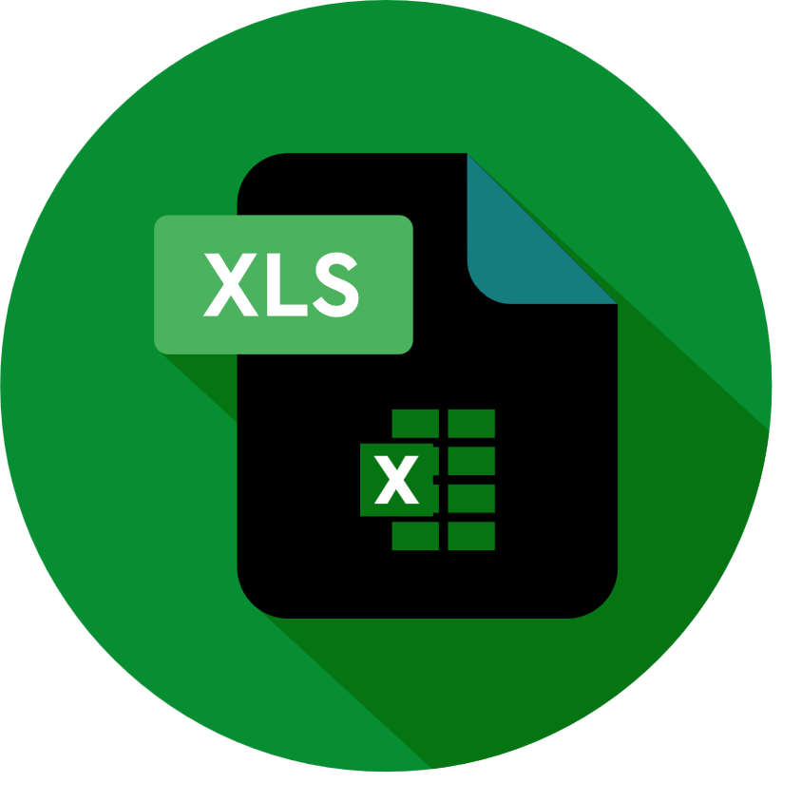



Explore Data
Maniupilate, Clean Data
modeling
Visualization
EXCEL
PYTHON
SQL
power Bi

Slide 7
Data description
This project leverages a comprehensive Employee Dataset designed to support human resource analytics and strategic workforce planning. The dataset includes detailed personal, professional, and demographic data for each employee. Below is a summary of the data structure:
Identification & Personal Info:
Emp ID, First Name, Middle Initial, Last Name
Gender, Date of Birth, Time of Birth, Age in Yrs
Family Details:
Father's Name, Mother's Name, Mother's Maiden Name
Contact Information:
E Mail, Phone No, User Name, Password
Employment Data:
Date of Joining, Quarter/Half/Year of Joining,atteration
Age in Company (Years), Salary, Last % Hike,Job title
Geographic & Location Info:
City, County, State, Zip, Region, Place Name
Additional Metadata:
Short Month, DOW of Joining, Short DOW

Slide 8
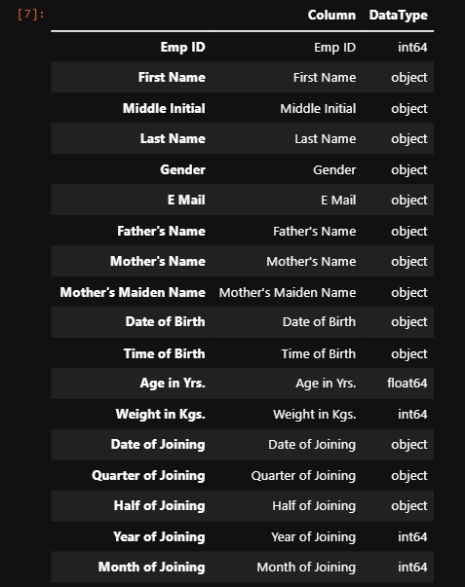
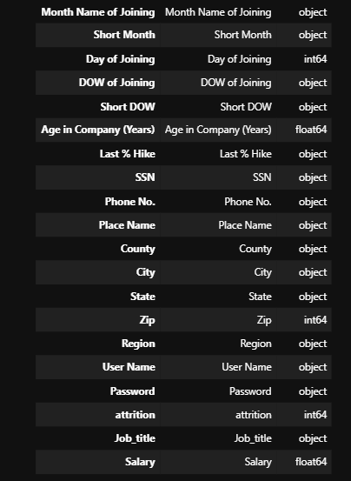
Data Characteristics

Slide 9
Data Characteristics
Calculated/Derived Fields
Created for deeper insights:
Age = Current Year - Date_of_Birth
Tenure_Group = Categorized from Experience_Years
Salary Band, Attrition Rate %, Success_Status flags

Slide 10
Data Defectives
Missing Values:
Cells or rows with absent data, which need to be handled by either removal
or imputation.
Duplicates:
Entire or partial repeated rows that should be removed to maintain data cleanliness.
Anomalies & Redundancies:
Data points that significantly differ from the rest of the dataset, often indicating errors or rare events. Repeated or unnecessary data that can increase storage requirements and reduce analysis accuracy.

Slide 11

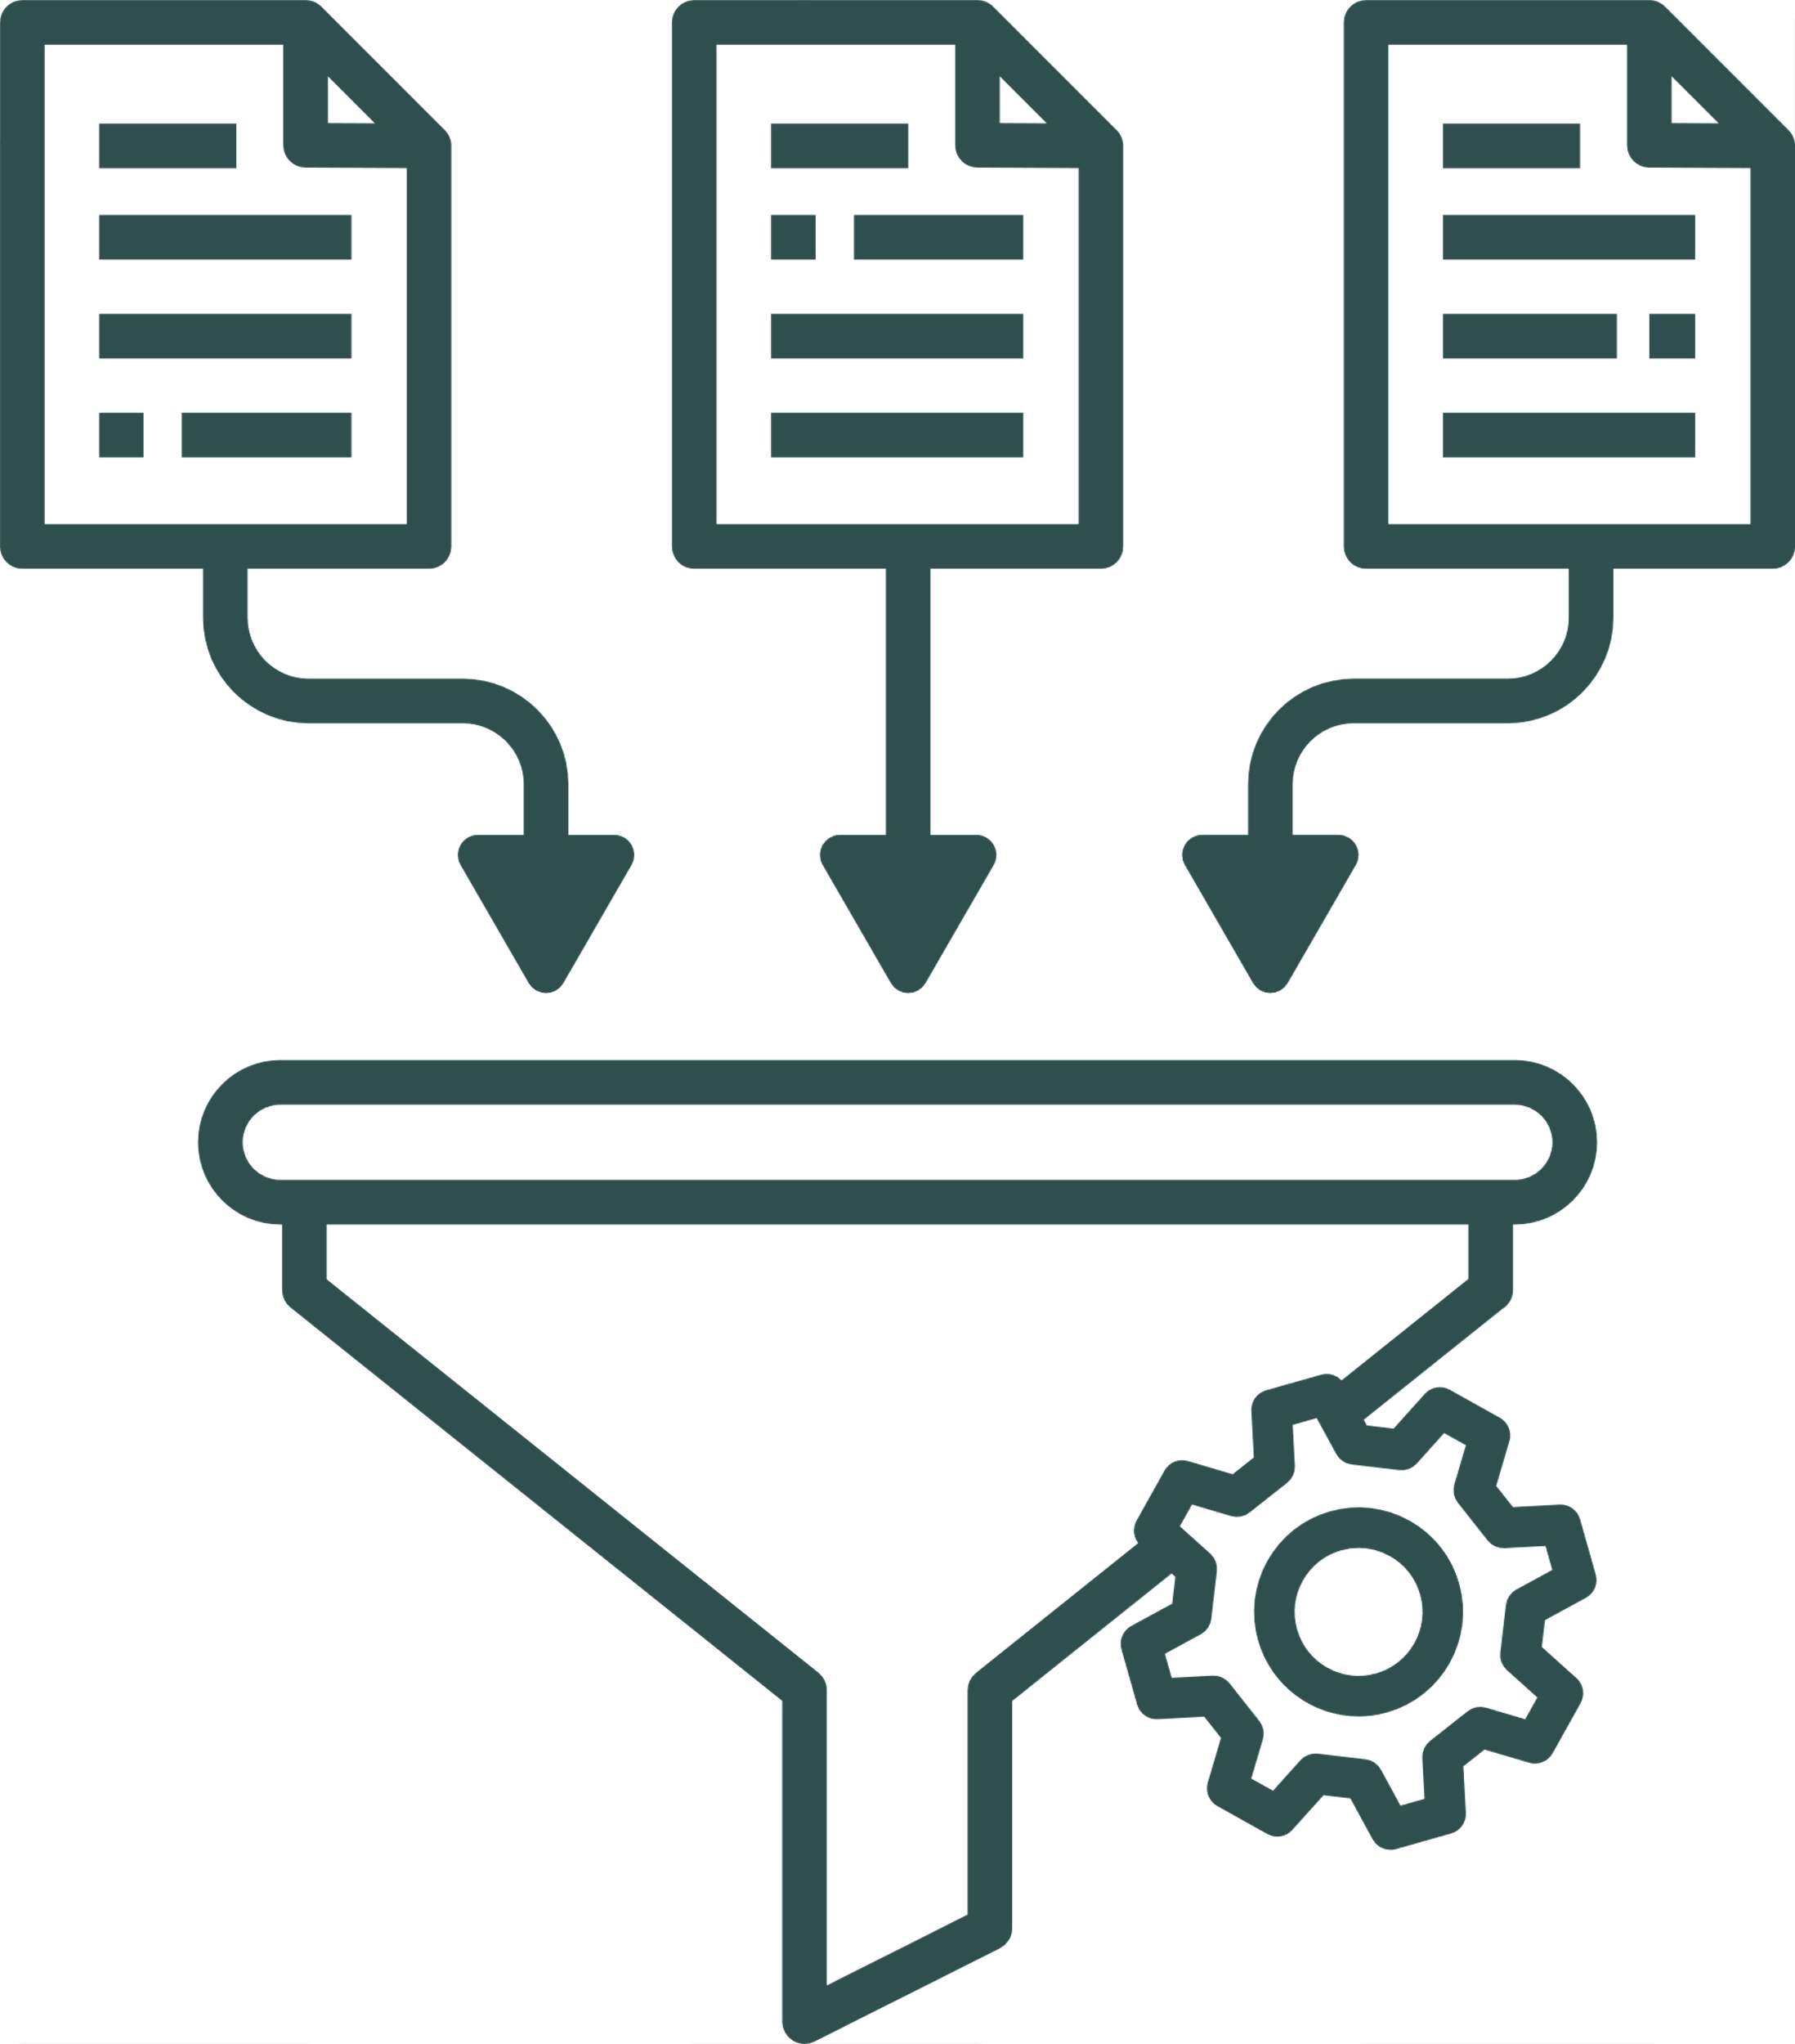
Cleaning

Slide 12
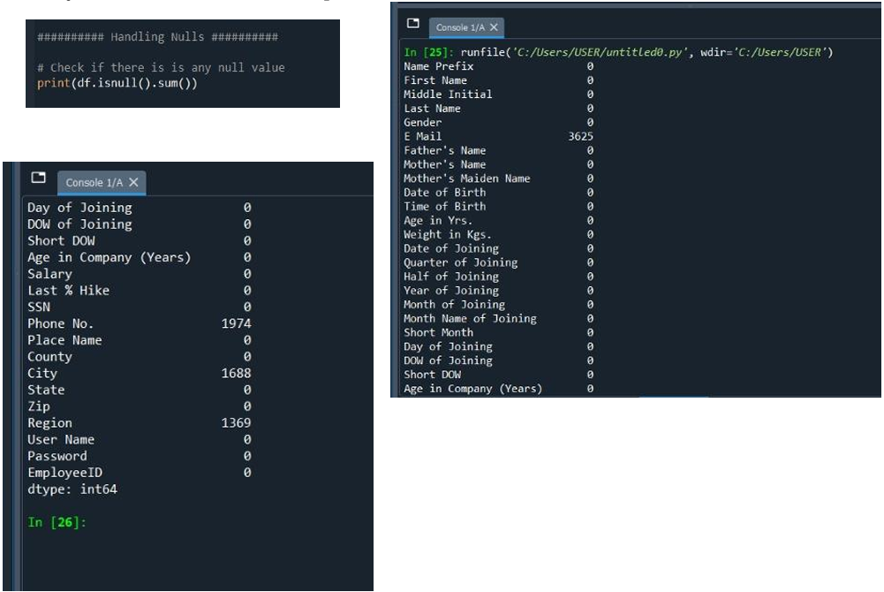
Data Issues:
Missing Values:
"Email": 3,625 missing.
"Phone No.": 1,974 missing.
"City": 1,688 missing.
"Region": 1,369 missing.
Next Slide: Solutions to handle missing values.

Slide 13
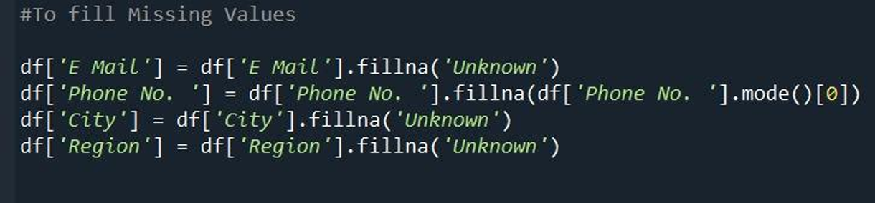
Handling Missing Data
This code handles missing values in key columns:
Fills missing emails, cities, and regions with 'Unknown'.
Fills missing phone numbers with the most common phone number (mode).
This step corrects data quality issues found earlier and ensures consistency before analysis.

Slide 14
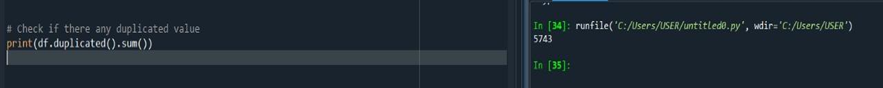

Checking for Duplicate Values
Dropping Duplicate Rows

Slide 15
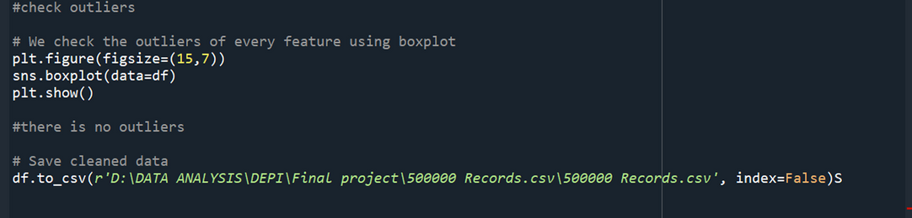
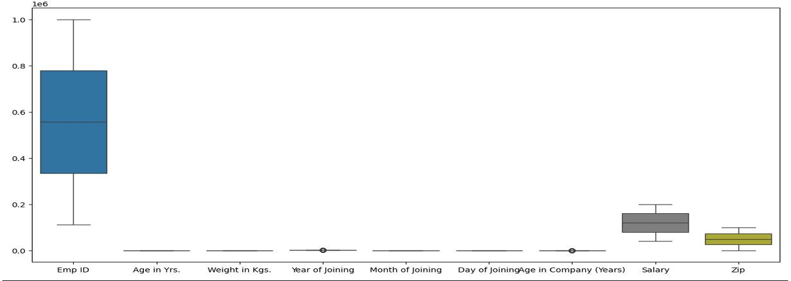
Check outliers and saved cleaned data

Slide 16
Modeling & schema

Slide 17
Building the Data Module
we examined the original structure of the dataset, which contained redundant and unstructured data. To improve data integrity, eliminate redundancy, and optimize performance, we performed normalization using SQL.
Solution Approach:
Normalization using SQL to reduce redundancy and improve data integrity.
Applied Star Schema for efficient querying and reporting.
Why Normalize?
Ensures each data point is stored only once.
Minimizes inconsistencies and storage use.
Makes data easier to manage and update.
Outcome: Clean, structured, and performance-optimized data model.

Slide 18
Benefits of Normalization
No Redundancy – Data stored only once.
Improved Consistency – Changes apply in one place.
Easier Maintenance – Smaller, focused tables.
Faster Queries – Optimized data processing.
Advantages of Star Schema Design
User-Friendly Structure – Simple and easy to navigate.
Improved Performance – Fewer joins, faster queries.
OLAP & BI-Ready – Compatible with Power BI, Tableau.
Better Data Aggregation – Designed for quick insights.

Slide 19
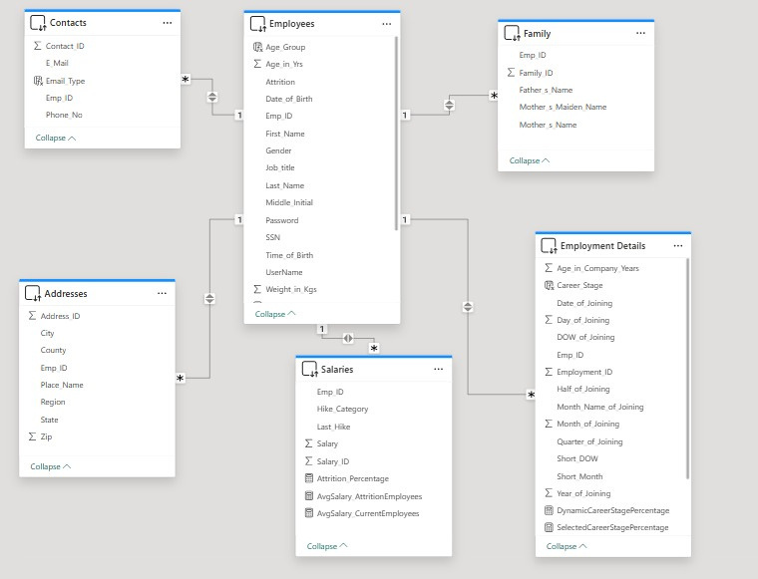

Slide 20
Employees
Family
6
Contacts
Employment details
Tables
500k rows
38 columns
Addresses
Salaries

Slide 21
How the Data Module Works
Central Table: Employees – stores key personal data (name, age, gender, job title).
Related Tables (linked via Emp_ID):
Salaries – salary details.
Contacts – phone numbers & emails.
Addresses – current and past addresses.
Employment Details – joining date, employment type.
Family – family member information.
Design Feature: All tables connected via foreign key (Emp_ID) to avoid duplication.

Slide 22
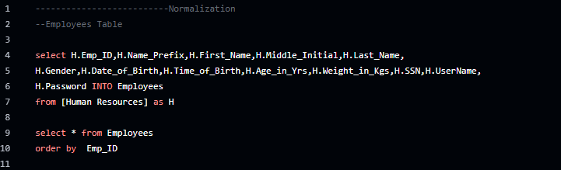
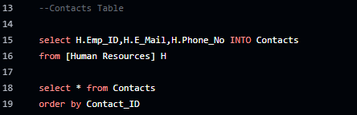
→ Normalization By SQL

Slide 23
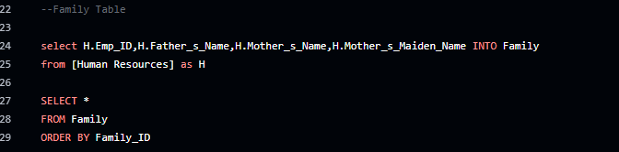
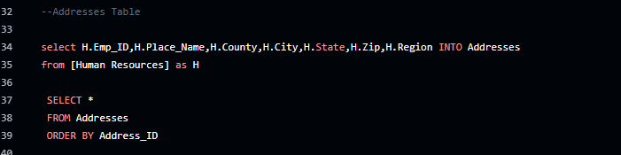
→ Normalization By SQL

Slide 24
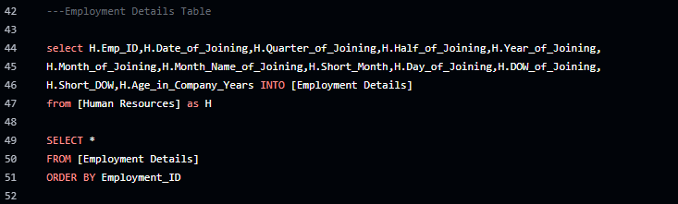
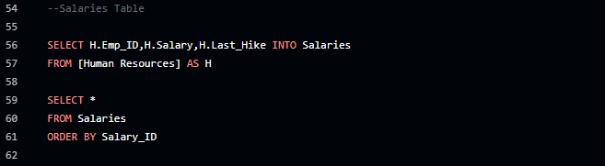
→ Normalization By SQL

Slide 25

Create and use Model to Perdict based Dataset

Slide 26

Future Business Assistant
Salary Model
is used to predict or analyze employee salaries based on factors like job role, experience, education, performance, and location.
It helps ensure fair pay, detect salary gaps, and support HR decisions like promotions or budgeting

Slide 27
Future Business Assistant
Attrition Model
is used to predict which employees are likely to leave a company.
It analyzes data like age, salary, job role, and years at the company to find patterns linked to employee turnover.
The goal is to help HR take action early to retain valuable employees.

Slide 28

Key Findings

Slide 29
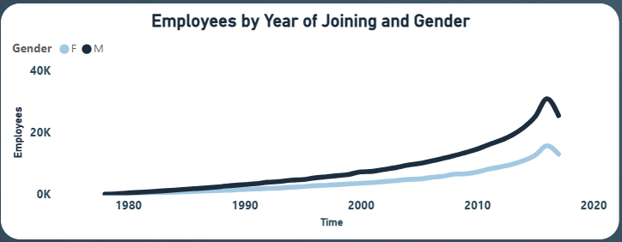
Steady employee growth over the years with a noticeable gender gap favoring males.

Slide 30
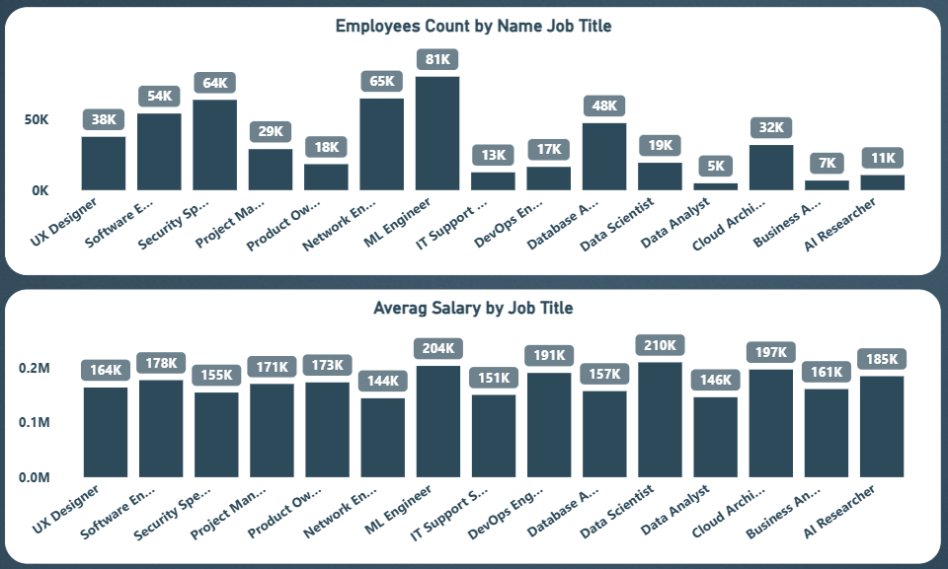
The charts show tech job distribution and average salaries in US companies. ML Engineers have the highest headcount with 81K employees, while AI Researchers have the lowest at 11K.
For salaries, Data Scientists top the list with an average of $210K, while IT Support roles are the lowest at $144K. This highlights the demand and value of different tech roles.

Slide 31
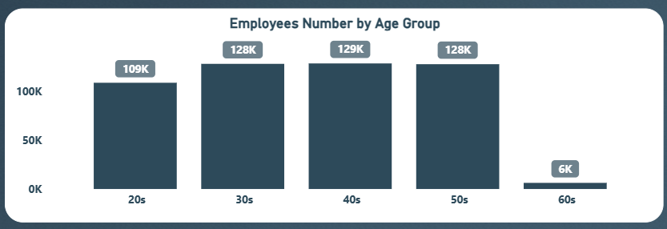
The majority of employees are in their 30s to 50s (around 128K–129K). The 20s group follows with 109K, while the 60s group has a significant drop at just 6K. This indicates a workforce concentrated in mid-age groups.

Slide 32
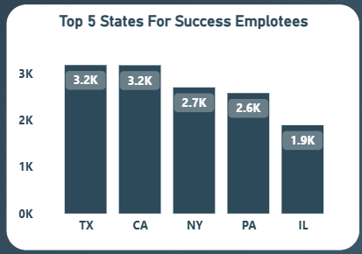
Texas and California have the highest number (3.2K), followed by New York (2.7K), Pennsylvania (2.6K), and Illinois (1.9K).

Slide 33

Attrition Analysis

Slide 34
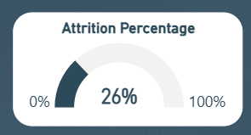
The attrition rate is 26%, indicating that over a quarter of employees have left the organization. This could signal potential retention challenges.

Slide 35
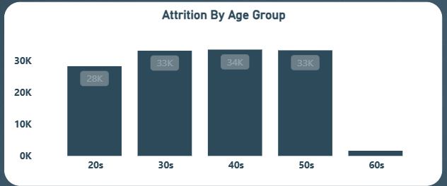
Most attrition occurs in the 30s to 40s age groups (33K–34K). The 20s group shows lower attrition (28K), while the 60s have minimal attrition, likely due to fewer employees or retirement.

Slide 36
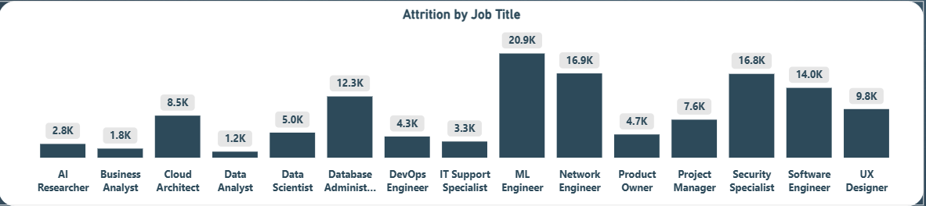
This chart shows employee turnover by job title in US tech companies. The highest attrition is among ML Engineers (20.9K), Network Engineers (16.9K), and Security Specialists (16.8K).
Interestingly, Network Engineers and Security Specialists were among the lowest five in average salaries, which might explain their higher turnover rates. Low pay could be driving them to leave.

Slide 37

Recommendations

Slide 38
1
1)Improving Employee Retention
Boost retention programs and incentives around mid-career and experienced employees.
2)Gender Diversity
Invest in programs to improve female hiring and promotion rates, especially in high-paying roles.
3

Slide 39
1
3)Salary and Hike Review
Review salary hike categories—only 32% get high hikes, which could impact morale.
Align rewards more closely with performance and tenure.
4)Regional Optimization
3
Explore hiring and development in underrepresented states (e.g., RI, DE, HI) to tap into new talent pools.

Slide 40

Next Steps:
Advancing Insights in Future

Slide 41
Key Enhancements for Future Analysis
1
1)A Predictive Analytics
Use machine learning models to predict attrition risks based on age, job title, region, and salary patterns.
2)Employee Sentiment Analysis
Implement regular employee surveys and integrate natural language processing to derive insights.
3)Diversity & Inclusion Dashboard
Develop metrics around not just gender, but ethnicity, disability, and age diversity.
3

Slide 42


Slide 43


